Slide 1
CSE ENGINEERING PROJECT
AI-Based Traffic Signal Control
with Ambulance Priority
Real-Time Ambulance Detection and Intelligent Traffic Signal Control
Divyansh Agarwal
Vishal Soni
Pranav Chauhan
Srikant Khatri
Ritam Deep Chowdhury
Member 1
Member 2
Member 3
Member 4
Member 5
Supervisor: Manorma Chouhan
VIT Bhopal University

Slide 2
The Problem
02 / 22
Signals run on predefined cycles
Ambulances may meet RED signals in emergencies
Manual emergency control needs human intervention
No automatic identification of an approaching ambulance
The lane needing priority must be determined
Problem statement
“How can a traffic signal automatically detect an approaching ambulance and provide GREEN priority to its lane?”

Slide 3
Existing System & Limitations
03 / 22
EXISTING SYSTEM
LIMITATIONS
Fixed timing cycle
Predefined GREEN/RED duration
Manual emergency handling
No ambulance awareness
No lane-level intelligence
Cannot respond dynamically
Ambulances may be delayed
Requires human intervention
Cannot identify emergency vehicles
Cannot determine emergency approach

Slide 4
Literature Review
04 / 22
01
02
03
04
Conventional traffic signal control
Computer vision-based traffic monitoring
YOLO-based object detection
Emergency vehicle priority systems
[INSERT ACTUAL RESEARCH PAPER REFERENCES]
Research gap
Existing approaches may address vehicle detection or signal control separately. This project combines ambulance detection, lane identification and automatic emergency signal control.

Slide 5
Proposed System & Methodology
05 / 22
Traffic Camera
Video Frames
YOLO11
Vehicle / Ambulance Detection
Lane Identification
→
→
→
→
Confidence Verification
Decision Logic
Traffic Signal Controller
RED / GREEN Output
→
→
→
YOLO11 detects vehicles and ambulances in each frame; a separate decision layer verifies confidence, picks the priority lane and drives the signal controller.

Slide 6
Novelty of the Project
06 / 22
DETECT
IDENTIFY
PRIORITIZE
CONTROL
Real-time ambulance detection
Lane-level emergency priority
Automatic signal decision
Separation of AI detection and control logic
↻ Automatic return to normal cycle
Once the ambulance clears, the regular signal cycle resumes.

Slide 7
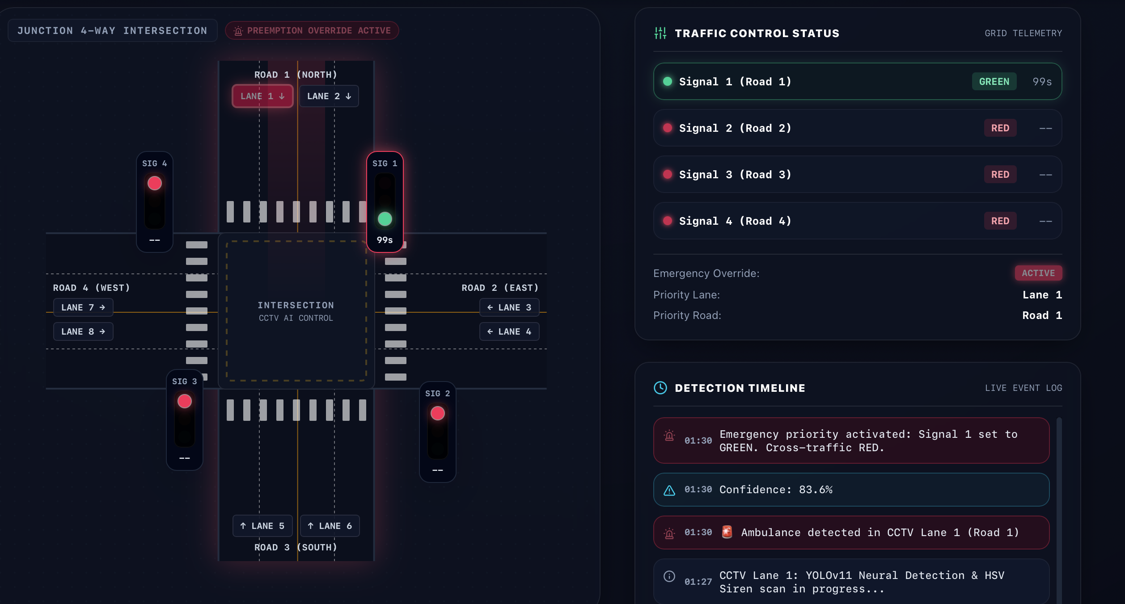
Real-Time Usage
07 / 22
Scenario: four-way road intersection with CCTV cameras
NORMAL
EMERGENCY
AFTER AMBULANCE
Normal signal cycle
Ambulance detected → lane identified → emergency priority → ambulance lane GREEN → conflicting lanes RED
Normal cycle resumes

Slide 8
Hardware & Software Requirements
08 / 22
HARDWARE
SOFTWARE
Computer / Laptop
Traffic CCTV / video camera
Display
Optional traffic-light / LED simulation
Python
YOLO11 · Ultralytics
OpenCV · NumPy
Video processing environment
Web-based interface
INPUT
OUTPUT
Traffic video / CCTV footage
Vehicle detection + ambulance detection + lane identification + signal control

Slide 9
Overall System Architecture
09 / 22
DETECTION LAYER
Traffic Camera
Video Frames
YOLO11
Vehicle / Ambulance Detection
→
→
→
↓
DECISION LAYER
Lane Identification
Confidence Check
Emergency Decision
→
→
↓
CONTROL LAYER
Traffic Signal Controller
RED / GREEN Output
→

Slide 10
Module Description
10 / 22
1 · Video Input
2 · Object Detection
3 · Ambulance Identification
4 · Lane Identification
Captures traffic/CCTV video and splits it into frames.
YOLO11 detects vehicles with class, box and confidence.
Maps the ambulance to a lane/approach.
Flags ambulance detections among all classes.
5 · Emergency Decision
6 · Traffic Signal Control
7 · Normal Cycle Recovery
Verifies confidence and decides on priority.
Ambulance lane GREEN, other lanes RED.
Restores the normal cycle once the ambulance clears.

Slide 11
Module Workflow
11 / 22
START
Capture Traffic Video
Process Frame
YOLO11 Detection
Ambulance Detected?
→
→
→
→
YES → Identify Lane
Verify Confidence
Emergency Priority
Ambulance Lane GREEN, Other Lanes RED
→
→
→
Ambulance Passes
Resume Normal Cycle
LOOP
→
→

Slide 12
Implementation & Coding
12 / 22
Python
YOLO11
Ultralytics
OpenCV
NumPy
Main programming language
Object detection
YOLO framework
Video / frame processing
Numerical operations
Video Input
→
OpenCV
→
YOLO11
→
Detection
→
Decision Logic
→
Signal Control
GITHUB REPOSITORY LINK: https://github.com/vishalsoni2006/emergency-vehicle-project.git

Slide 13
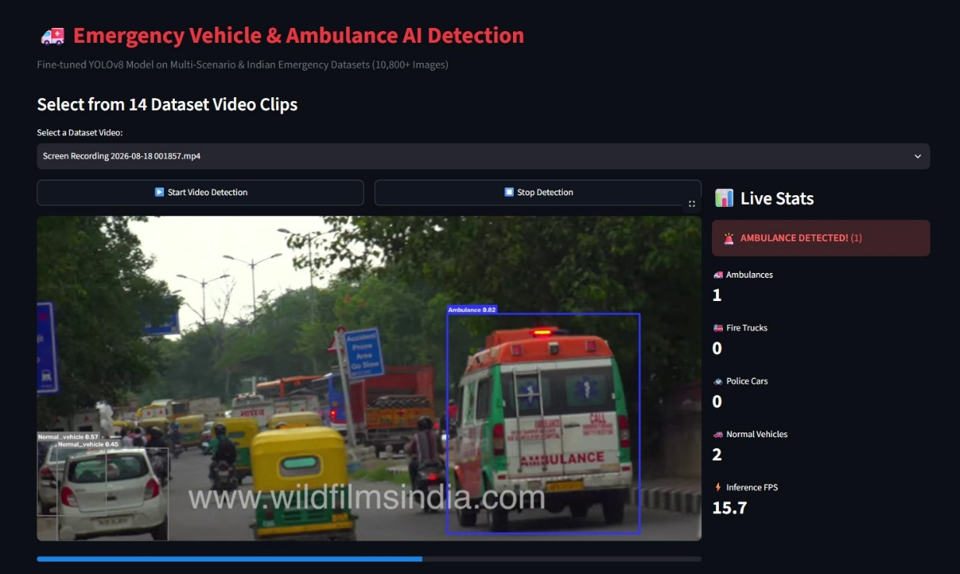
YOLO11 Detection Model
13 / 22
Real-time object detection
Vehicle detection
Ambulance identification
Bounding boxes and confidence scores
Video-frame processing
Detection output
(Class, Bounding Box, Confidence)
“YOLO11 acts as the visual perception layer of our system.”

Slide 14
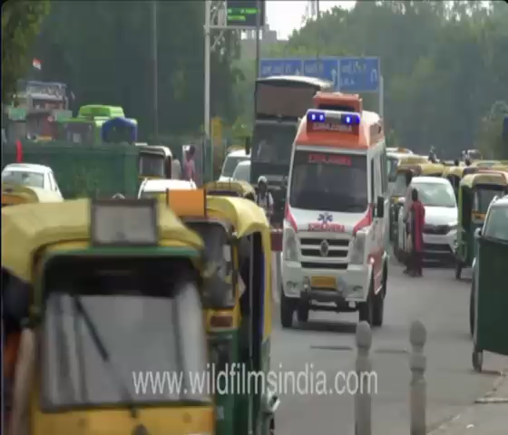
System Demonstration
14 / 22
1 · Normal traffic
2 · Ambulance detection
3 · Lane identification
4 · Emergency GREEN
5 · Conflicting RED
6 · Ambulance passes
7 · Normal cycle resumes

Slide 15
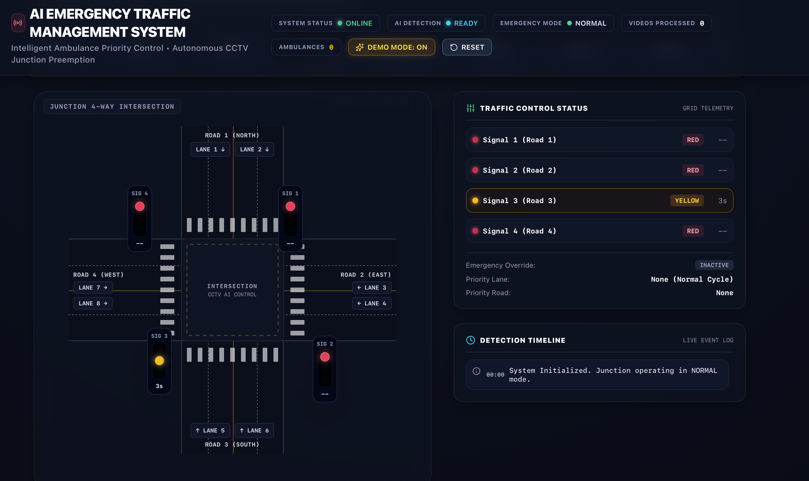
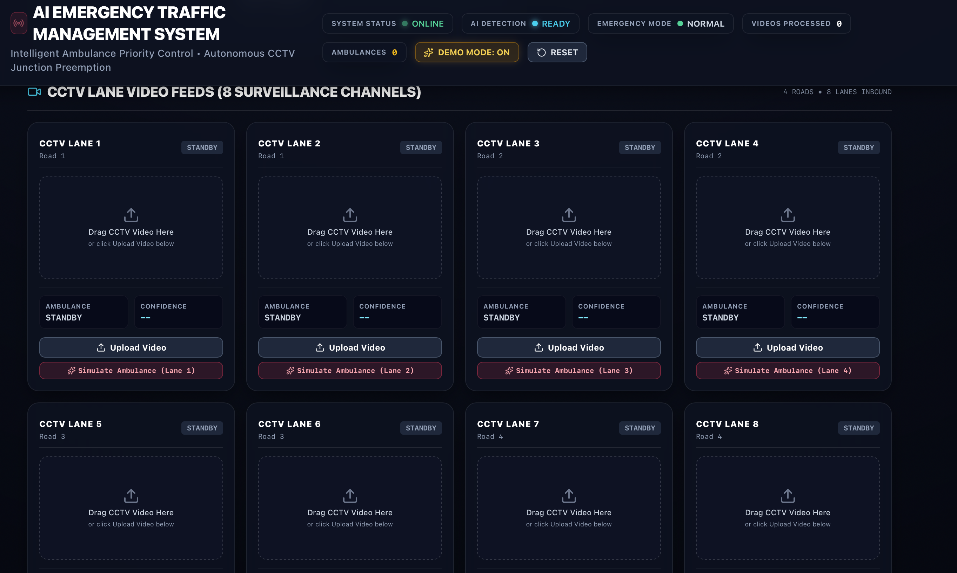
Project Interface
15 / 22
Video input
Detection output

Slide 16
Emergency Priority Decision
18 / 22
Ambulance Detected?
Identify Lane
Confidence Check
Emergency Mode
→
→
→
Ambulance Lane GREEN, Other Lanes RED
Ambulance Clears
Normal Cycle
→
→
YOLO11 performs detection
The separate decision layer controls the signal
The visual perception layer.
Confidence check, emergency mode, signal output.

Slide 17
Traffic Signal Control
19 / 22
NORMAL MODE
EMERGENCY MODE
Signals follow the normal cycle
Example: ambulance from NORTH
NORTH
NORTH
SOUTH
SOUTH
EAST
EAST
WEST
WEST
Ambulance Clears → Resume Normal Cycle

Slide 18
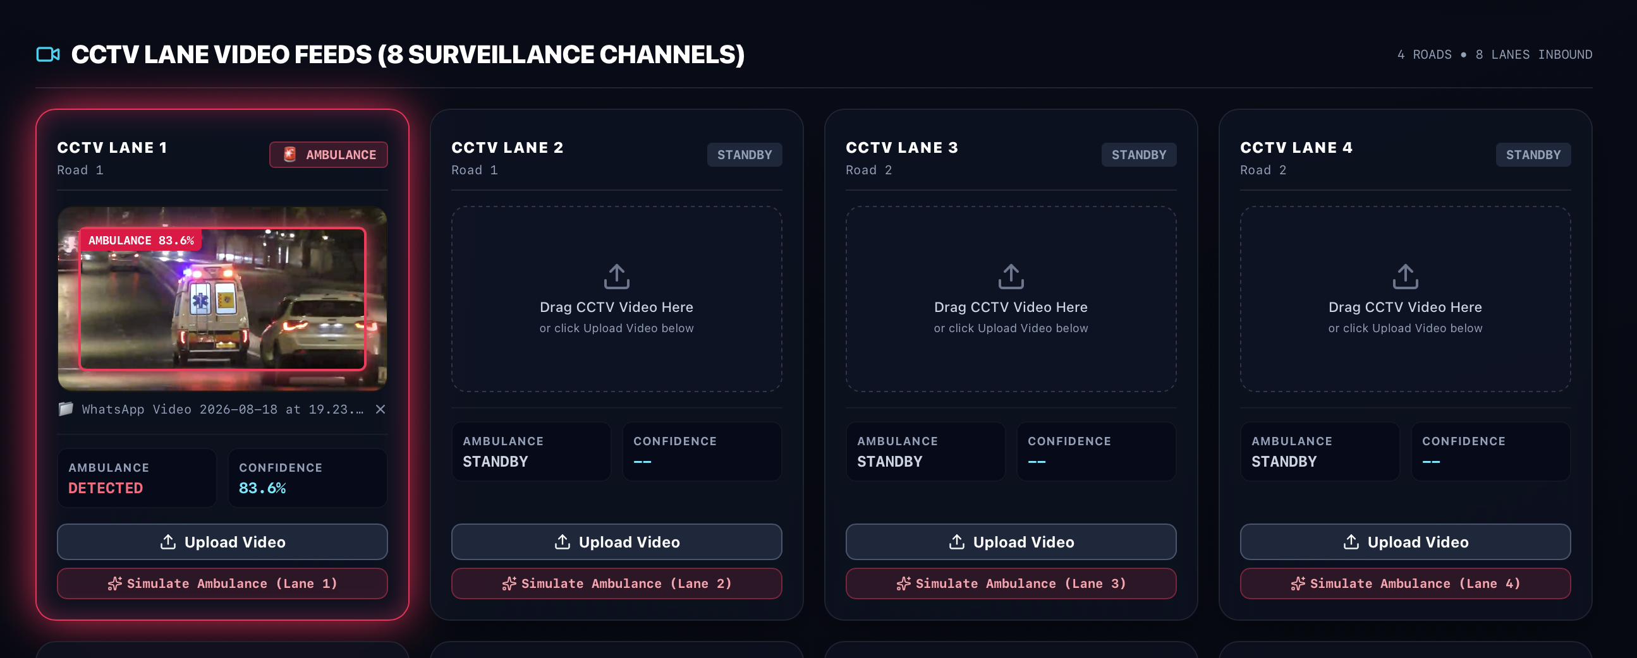
Testing
20 / 22
Test Case | Expected Result
No ambulance | Normal signal cycle
Ambulance from North | North GREEN
Ambulance from South | South GREEN
Ambulance from East | East GREEN
Ambulance from West | West GREEN
Low-confidence detection | No immediate priority
Ambulance clears | Normal cycle resumes

Slide 19
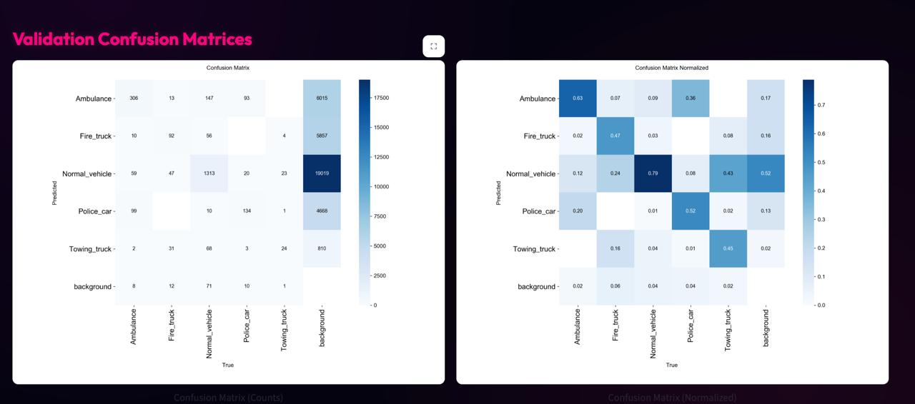
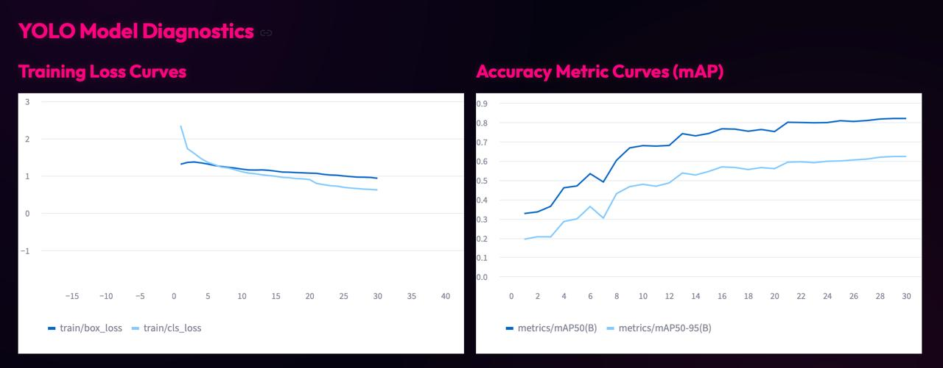
Results & Discussion
21 / 22
424 / 550
actual ambulance instances
correctly detected
≈ 77.1%
Ambulance recall
Discussion
Metrics
High recall is important: missed ambulances can prevent emergency priority.
False positives need further reduction for reliable traffic-signal control.
Precision = TP / (TP + FP)
Recall = TP / (TP + FN)
Input
→
YOLO11
→
Decision Layer
→
Signal Output

Slide 20
Conclusion & Future Scope
22 / 22
CONCLUSION
FUTURE SCOPE
The system combines computer vision and automated traffic control to detect an ambulance and provide priority to its lane.
Multi-intersection ambulance tracking
Multiple emergency vehicles
Night-time / adverse-weather detection
Improved occlusion handling
Real traffic-light hardware integration
GPS / V2X integration
Edge-device deployment
Real-time vehicle detection
Ambulance identification
Lane-based emergency detection
Automatic signal decision
Reduced manual intervention
Thank You

